Slide 1
Trusted Repository Systems Overview
DASPOS Bootcamp
University of Chicago
Dec. 19, 2012
Rick Johnson
Hesburgh Libraries
University of Notre Dame
Notes:
Set of best practices to use as a guide

Slide 2
Why Trusted Repositories?
The Task Force on Archiving of Digital Information (1996) declared, “a critical component of digital archiving infrastructure is the existence of a sufficient number of trusted organizations capable of storing, migrating, and providing access to digital collections.” The task force saw that “trusted” or trustworthy organizations could not simply identify themselves.
Can we really count on commercial entities to exist in 10 years?
A trusted repository is more than off-site backup
Unclear what makes a repository trusted
Notes:
The key here is that a litmus test of set criteria was established to affirm a system is trusted

Slide 3
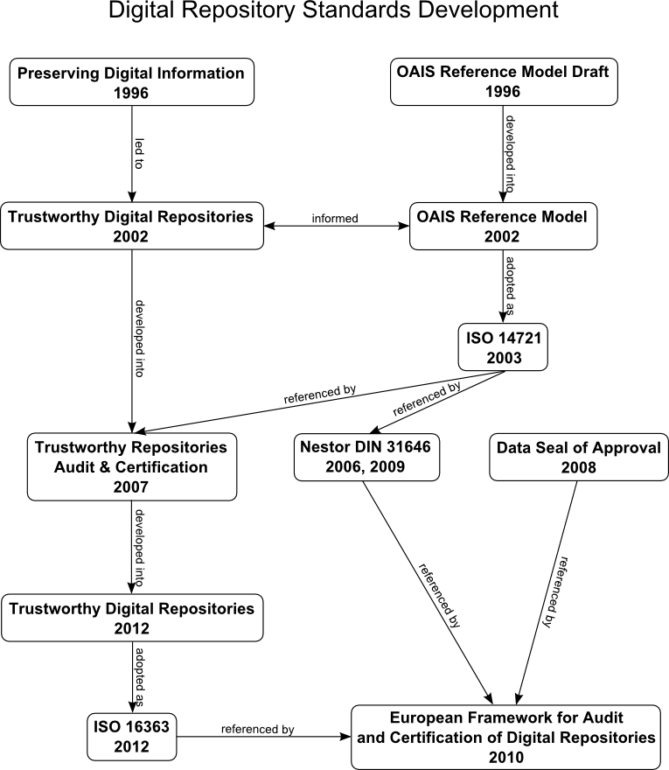
*http://commons.wikimedia.org/wiki/File:Digitalrepositorystandards.png
Notes:
Unclear what makes a repository trusted

Slide 4
What is Trustworthiness?
from Trusted Digital Repositories: Attributes and Responsibilities (TDR):
A trustworthy repository must implement “a mission to provide reliable, long-term access to managed digital resources to its designated community, now and into the future”.
* “PURR and ISO 16363 Preparation” Matthew Kroll and Michael Witt, Open Repositories 2012

Slide 5
OAIS Mandatory Responsibilities
Negotiating and accepting information
Obtaining sufficient control of the information to ensure long-term preservation
Determining the "designated community"
Ensuring that information is independently understandable
Following documented policies and procedures
Making the preserved information available

Slide 6
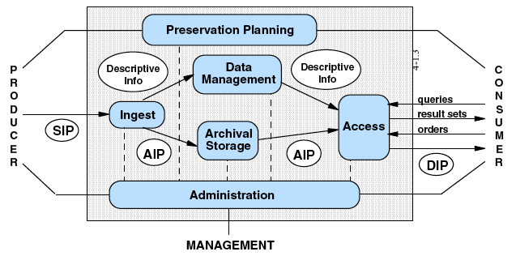
OAIS

Slide 7
Information Package Variants
Submission Information Package (SIP)
Archival Information Package (AIP)
Dissemination Information Package (DIP)
Notes:
The necessary access and query paradigm can dictate how something is structured

Slide 8
Three Important Qualities of Trustworthiness
Integrity
Sustainability
Support
* “PURR and ISO 16363 Preparation” Matthew Kroll and Michael Witt, Open Repositories 2012

Slide 9
3 Sections of Criteria
Organizational Infrastructure
Digital Object Management
Infrastructure and Security Risk Management
Approximately 109 criteria in all
TRAC Certification
Certification offered by Center for Research Libraries here in Chicago
Full Certification Details:
http://www.crl.edu/sites/default/files/attachments/pages/trac_0.pdf

Slide 10
Organizational Infrastructure
Governance and Organizational Viability
Organizational Structure and Staffing
Procedural Accountability and Preservation Policy Framework
Retention polices, etc.
Financial Sustainability
Contracts, Licenses, and Liabilities

Slide 11
Digital Object Management
Ingest: Acquisition of Content
Ingest: Creation of the AIP
Preservation Planning
i.e. migration, transformation, health checking
AIP Preservation
Information Management
Access Management
Data Integrity Checking

Slide 12
Infrastructure and Security Risk Management
Technical Infrastructure Risk Management
Proper redundancies, load balancing, replication of content
Security Risk Management
Proper access, intellectual property, and privacy controls

Slide 13


Example Trusted Repository Systems
Chronopolis
Hathi Trust
Stanford Digital Repository

Slide 14
What Metadata to Capture?
All about what do you want to do with the data, like Kyle’s RECAST slide
Reuse
Analyze in a new way
Correlate with other data
Share linked to publication
Migrate to newer content
Archive analysis notes in some expected structure?
Preserve for funders

Slide 15
How Does it Apply to Us
Inform the design philosophies of preservation layer recommendations
Organizational, process, technology, and infrastructure sustainability
OAIS SIP and AIP somewhat applicable
Collect and store metadata necessary to ensure migration, reuse, access, etc.
Access and dissemination layer more complex
Notes:
It is the spirit of why we have these standards as opposed to specfics, formal organizational support structure, many copies of data

Slide 16
How Does it Apply to Us
Does not dictate how you structure data
Does not dictate base archival technology
It DOES inform categories of metadata collected
Preservation applies to tools as well!
Inform future trusted criteria?
Notes:
It is the spirit of why we have these standards as opposed to specfics, formal organizational support structure, many copies of data

Slide 17
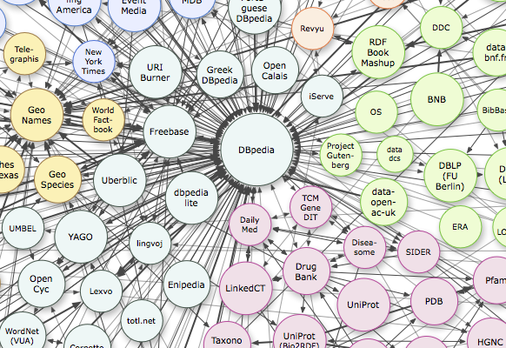
Finding Our Data
*Linking Open Data cloud diagram, by Richard Cyganiak and Anja Jentzsch. http://lod-cloud.net/
Notes:
1717
1717
Of data that is released and tied to publications, how do we find and reuse it?

Slide 18
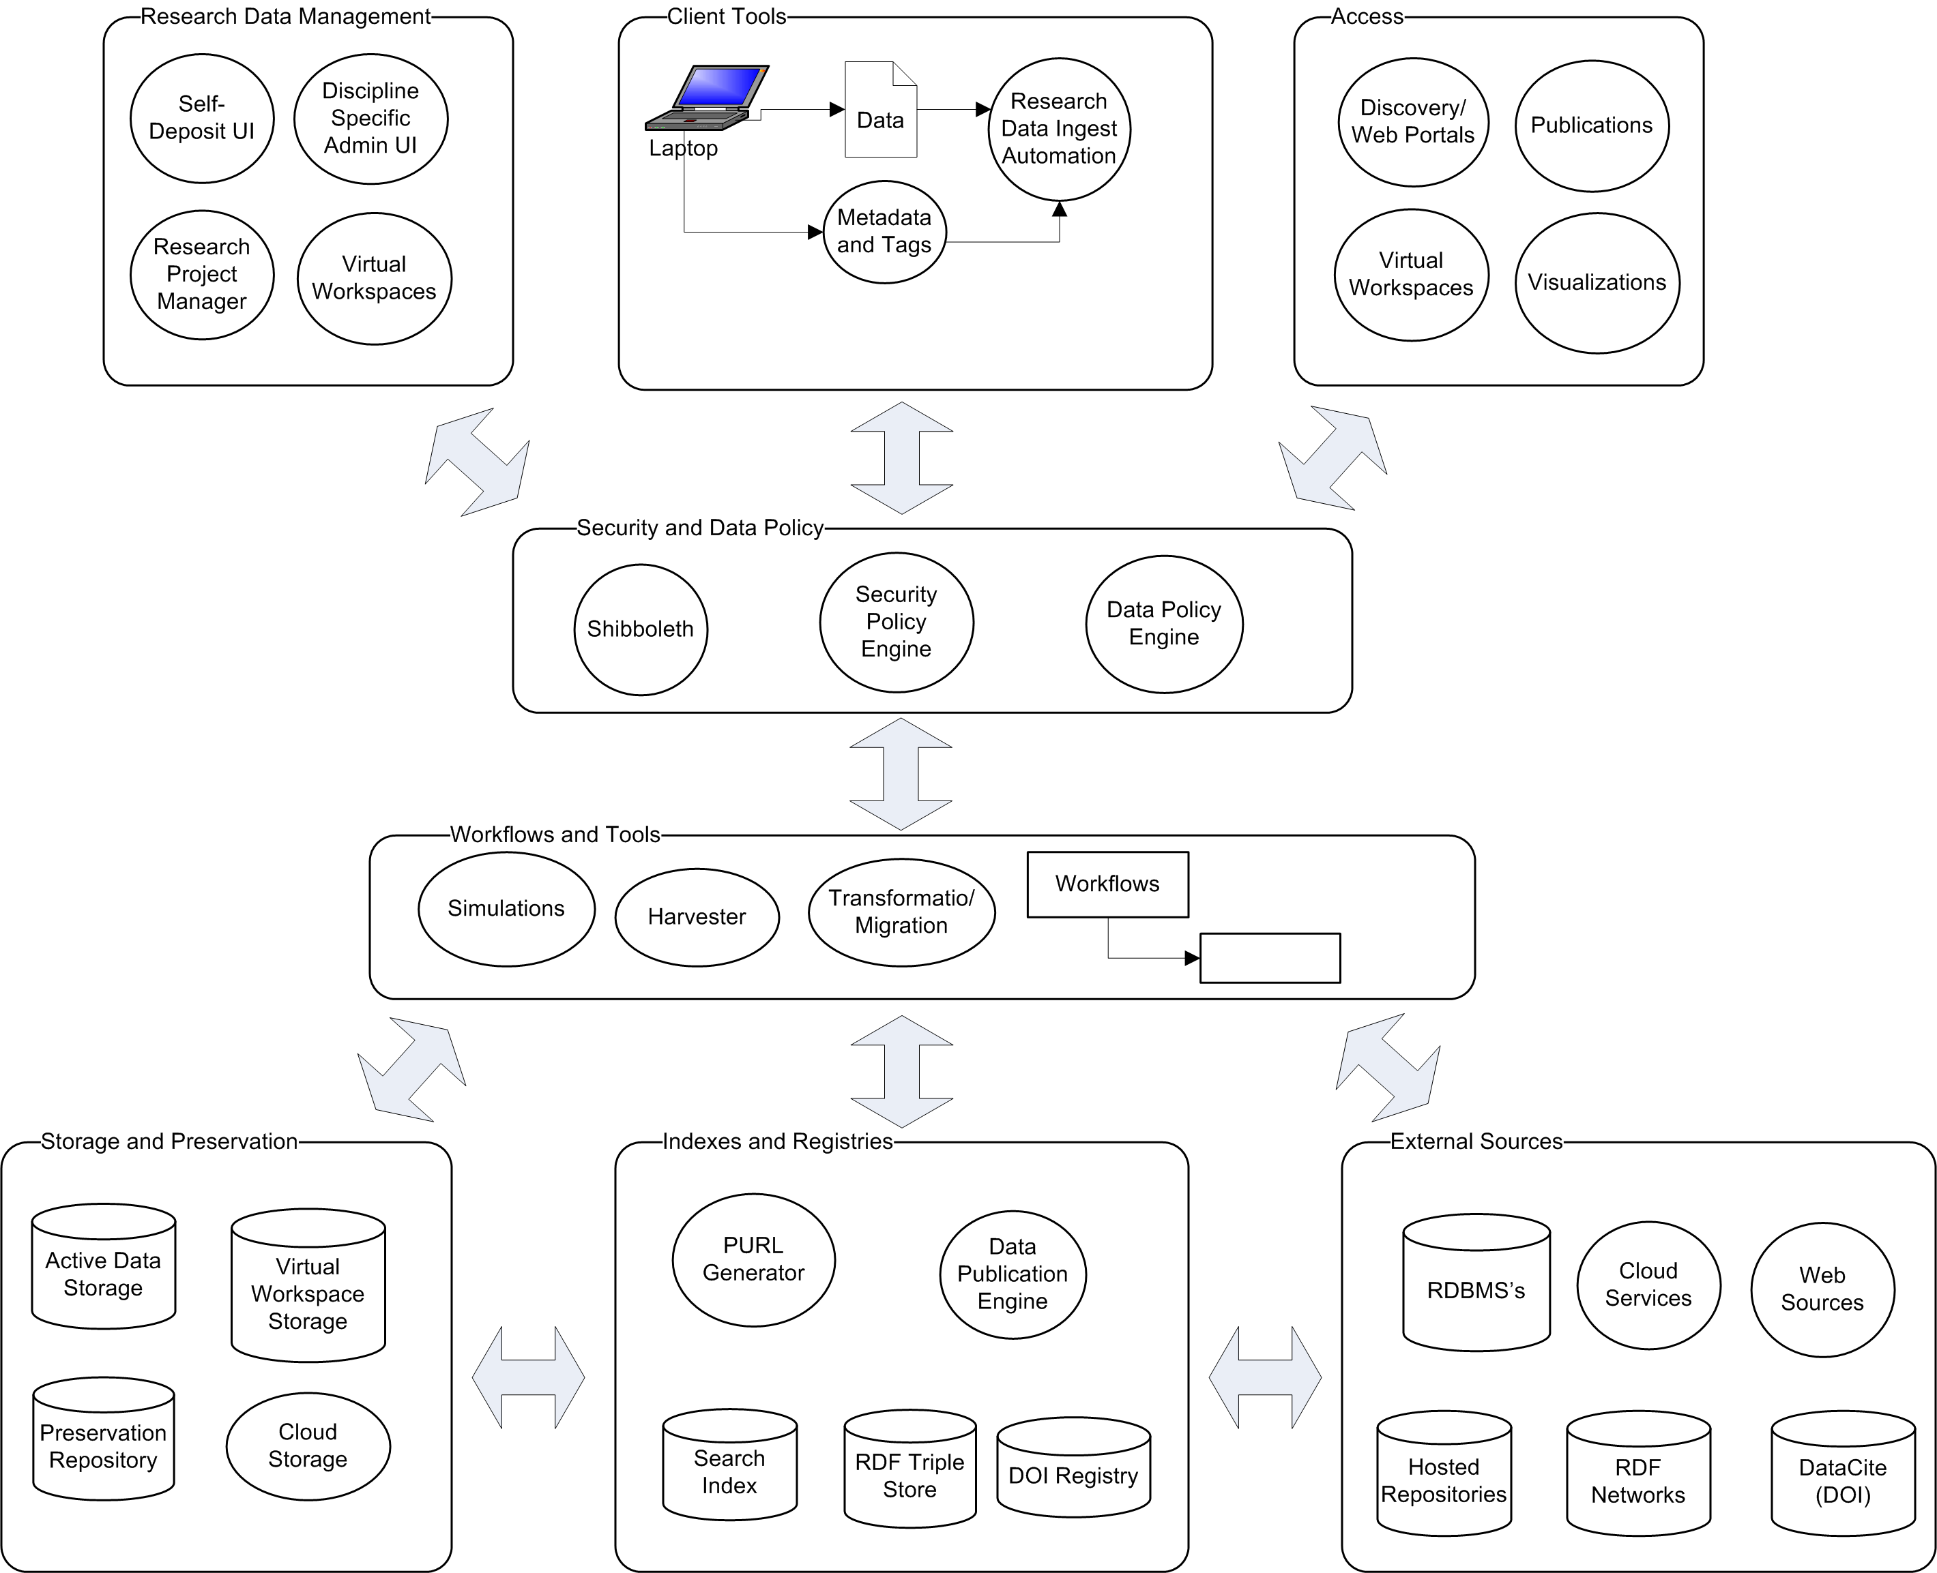
Notes:
Access and Dissemination patterns go beyond OAIS….Virtual workspaces and tools are all about capturing a snapshot of computational and analytical environment for data, is it conceivably possible to create virtual environments? The repository here is an abstraction of what would be multiple nodes in a larger architecture

Slide 19
Core Services
Preservation (storage, replication)
Health checking
Citation (of datasets? statistics?)
Indexing and Discovery
Reuse
Reanalyze? Feed into new experiment?
Virtualizations?
Simple Deposit/ingest
Migration (enable reuse)
Notes:
Some problems are probably already solved

Slide 20
References
OAIS Standard
Trusted Repository Report 2002, http://www.oclc.org/resources/research/activities/trustedrep/repositories.pdf
Trusted Repository Audit and Certification Checklist, 2007
http://www.crl.edu/sites/default/files/attachments/pages/trac_0.pdf
Trustworthy Digital Repositories 2012 Draft
http://public.ccsds.org/publications/archive/652x0m1.pdf

Slide 21
Other References
“PURR and ISO 16363 Preparation” Matthew Kroll and Michael Witt, Open Repositories 2012
“The Reference Model for an Open Archival Information System (OAIS)”, Carlo Meghini, Preserving Digital Objects - Principles and Practice DPE, Planets CASPAR and nestor joint training event, Prague, Czech Republic, October 13-17, 2008

